Slide 1
Cross Validation
Dr Muhammad Ismail Mangrio

Slide 2
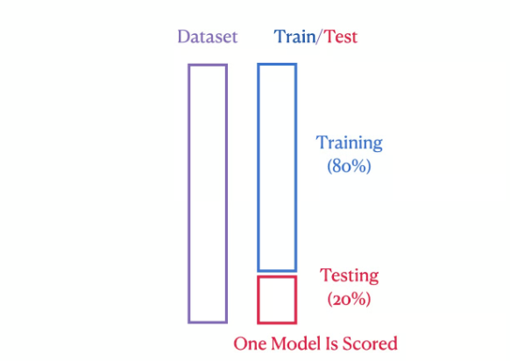
Training and Test Data split

Slide 3
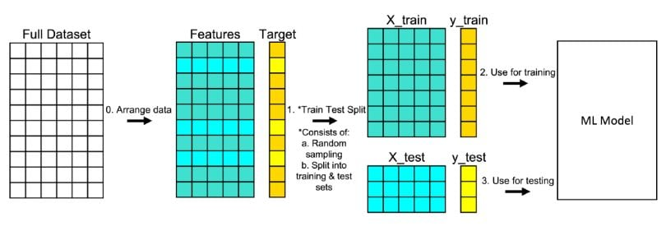
Training and Test Data split

Slide 4
Training and Test Data split
Train-Test Split:
Train → Learn the model
Test → Evaluate model
But what if we got lucky or unlucky with our split?
What if test data doesn’t represent the whole dataset?

Slide 5
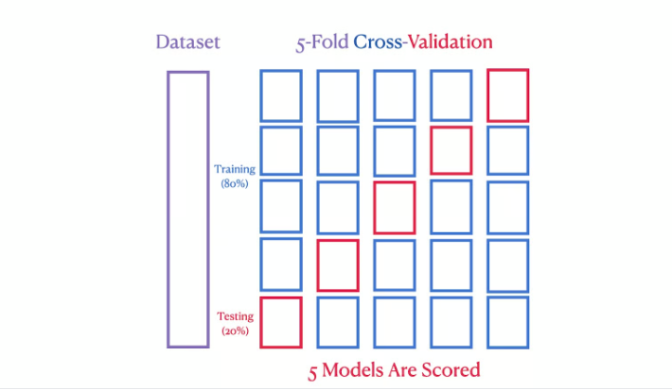
K-fold Cross Validation

Slide 6
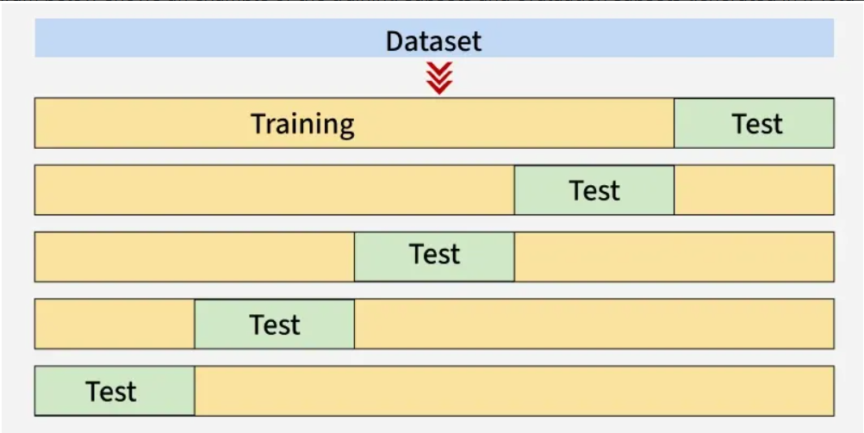
Cross Validation

Slide 7
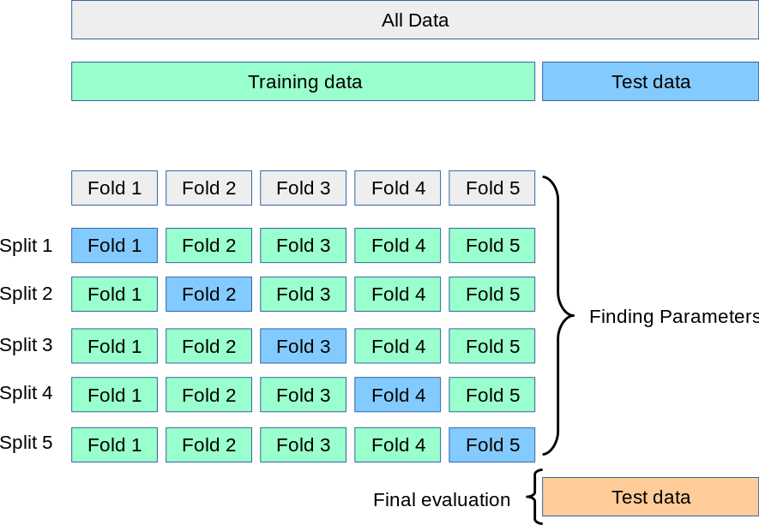
Cross Validation

Slide 8
Cross Validation
Cross Validation is a method to check how well our model generalizes to unseen data by testing it on different parts of the data.
[1, 2, 3, 4, 5, 6, 7, 8, 9, 10]
Fold | Train Data | Test Data
1 | 2–10 | 1
2 | 1, 3–10 | 2
3 | 1–2, 4–10 | 3
4 | 1–3, 5–10 | 4
5 | 1–4, 6–10 | 5
Each time:
Train the model on 4 parts
Test on the 1 part left out
Then average all 5 results → this gives a more reliable accuracy

Slide 9
